Slide 1



Hardware and Software Fundamentals of Intelligent Computing Systems

Slide 2
Lecture 34: Fault Tolerance and Checkpointing

Slide 3
Outlines
Background
Fault in Large-Scale Training
Fault Types and Impact Analysis
Checkpoint-Based Fault Tolerance System
Anomaly Detection
Checkpoint
Checkpoints in Distributed Training
Synchronous/ Asynchronous Checkpoints
Checkpoint Strategies
Checkpoint Storage Optimization Techniques
Industrial Case Studies
Robust LLM Training Infrastructure at ByteDance
Notes:
Fault tolerance and Checkpointing: fault handling in Distributed Training, with asynchronous saving of model weights.
Efficient Training of Large Language Models on Distributed Infrastructures: A Survey
https://arxiv.org/pdf/2407.20018 Chapter 8
Checkpoint and Fault tolerance mechanisms
https://apxml.com/zh/courses/mlops-for-large-models-llmops/chapter-3-llm-training-finetuning-ops/checkpointing-fault-tolerance
https://apxml.com/zh/courses/how-to-build-a-large-language-model/chapter-19-checkpointing-fault-tolerance
Megatron-LM
https://github.com/NVIDIA/Megatron-LM
https://developer.nvidia.com/megatron-core
Robust LLM Training Infrastructure at ByteDance [SOSP’25]
https://dl.acm.org/doi/10.1145/3731569.3764838

Slide 4
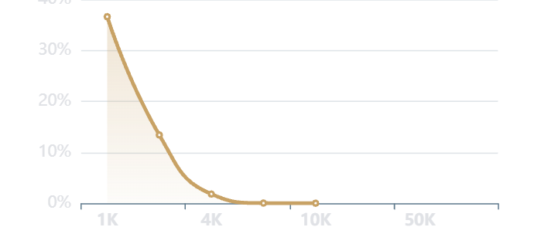
Background: Fault Conditions in Large-Scale Training
Failure Rates Exhibit Exponential Growth with Cluster Size
Mean Time Between Failures (MTBF) is a critical metric for evaluating cluster reliability
As the number of GPUs (N) increases, the probability of completing training without interruption decreases exponentially.
If the probability of a single GPU failure within a specified interval is p, then the probability of the entire cluster remaining stable is (1-p)^N.
Qianka Cluster ( p=0.001 ) => Success Rate ~36%
Wanka Cluster ( p=0.001 ) => Success Rate ~0.0045%
Cluster MTBF Data Comparison
Cluster Size vs Probability of Failure-Free Operation Within a Specified Timeframe
Cluster Size | MTBF | Data Source
1,024 GPUs | 7.9–25.8 hours | Google Borg Cluster Analysis
1,440+ GPUs | 2.67 hours | Microsoft GPU Cluster Report
16,384 GPUs (Llama 3) | 1.8–3 hours | Llama 3 Training Empirical Statistics
131,072 GPUs | 14 minutes | Google Large-Scale Cluster Study
Notes:
data src:
https://nebius.com/blog/posts/how-we-build-reliable-clusters
https://arxiv.org/abs/2512.13488
https://www.datacenterdynamics.com/en/news/meta-report-details-hundreds-of-gpu-and-hbm3-related-interruptions-to-llama-3-training-run/

Slide 5
Background: Fault Conditions in Large-Scale Training
Failure Cause Analysis
System complexity: Training system comprises an extensive component, whereby weaknesses in any segment are magnified.
Extended time span: Model training often extends over several months, thereby increasing the window for fault occurrence.
Failure propagation in training: Under synchronous training paradigms, a failure in a single node results in the termination of the entire training job, rendering the system highly susceptible to localized faults.
Real-world examples
Meta OPT-175B (992 A100 GPUs): Over 40 failures occurred within a two-week period.
Acme (1000+ A100 GPUs): On average, one fault occurs every 1–2 days during training.
ByteDance MegaScale (12,288 GPUs): Experienced over 100 faults within several weeks.
Economic cost impact
Time loss: Each Fault recovery takes 10-30 minutes; frequent interruptions severely slow progress.
Compute resource waste: The Wanka Cluster costs tens of thousands of dollars per hour, and failures leave resources idle.
Retraining overhead: Resuming from the previous Checkpoint requires recomputing unsaved iterations.
Duan J, Zhang S, Wang Z, et al. Efficient training of large language models on distributed infrastructures: a survey[J]. arXiv preprint arXiv:2407.20018, 2024.

Slide 6
Background: Analysis of Fault Types and Impacts
Meta Llama 3 405B Training Report
54 days, 16,384 H100 GPU, 419 unexpected interruptions (average of one failure every 3 hours)
Hardware level (58.7%)
GPU Hardware/NVLink (30.1%): 148 failures, physical challenges arising from hyperscale interconnects.
HBM3 VRAM (17.2%): 72 failures, mainly because the thermal stress from high power draw leads to semiconductor fatigue.
SRAM and processors (8.6%): 36 failures, with fragile low-level circuitry failing under heavy workloads.
CPU Failures: only 2 failures (a stark contrast, showing GPU clusters are far less stable than traditional CPU clusters)
Connection layer: network and infrastructure (8.4%)
Key points: switch and cable failures (35 occurrences), involving RoCE/IB network protocols and NCCL communication.
System and environment layer (33%)
Uncontrollable variables: software Bug, configuration errors, and 1-2% throughput fluctuations due to ambient temperature (triggering GPU thermal protection or frequency throttling).
https://www.datacenterdynamics.com/en/news/meta-report-details-hundreds-of-gpu-and-hbm3-related-interruptions-to-llama-3-training-run/

Slide 7
Checkpoint-based Fault Tolerance System
1. Automated fault detection
Function: real-time monitoring, capturing node crashes, process exits, or network interruptions at second-level granularity.
2. Automated task recovery
Action: After a failure is detected, the system automatically restarts the failed process or schedules a new node to replace the faulty node.
Seamless relaunch: Configure startup script so that after a restart, they automatically detect and load the latest valid checkpoint.
3. Deep integration with distributed frameworks
DeepSpeed: Built-in node-failure handling supports reintegrating new nodes into the communication group and automatically reconstructing sharded data.
PyTorch FSDP: Provides a dedicated distributed Checkpoint API, simplifying the logic for saving and loading large-scale sharded weights.
4. Flexible handling of partial failures
Elastic scaling: If some nodes fail, the system can continue training using the remaining nodes, or pause smoothly while waiting for resources to be restored.
Dynamic reconfiguration: Ensures the training topology remains communication-efficient after node changes.

Slide 8
Anomaly Detection Methods
Statistical Monitoring: Real-time fault handling
Continuous observation based on system-level metrics enables fault detection within seconds.
Monitoring architecture: “Single-GPU independent process + central-node heartbeat”
Hardware dimension (NVIDIA DCGM):
Compute performance: Monitor SM utilization and pipeline saturation.
GPU memory health: Prioritize monitoring Row-remapping metrics to anticipate HBM3 memory-cell degradation.
Interconnect: Track PCIe and NVLink traffic throughput in real time.
Communication dimension (network performance):
Traffic analysis: Monitor RDMA traffic, NCCL/TCP timeouts, and task hangs.
Deep diagnostics: Combine Meta NCCLX and PyTorch Flight Recorder to enable retrospective tracing of kernel activity and communication metadata.
Proactive Validation: Preventive checks
Filter out anomalous nodes via automated testing before failures occur.
Preflight: Run end-to-end connectivity and hardware health checks before the task starts.
Layered validation (Vela): Run periodic lightweight tests at runtime; run deep, intrusive stress tests when idle.
Standardized tools: Use benchmark suites such as SuperBench to evaluate each hardware component independently.

Slide 9
LLM Training Checkpoint
Checkpoint: Periodically saving the state of a training job
Checkpoint components: model parameters, weights, optimizer state, current training epoch or step...
The Importance of Checkpoints
1. Training Resilience and Fault tolerance
Core function: Handle hardware failures, preemptible instance termination, or system crashes.
Use cases: Automatically restart from the latest progress to minimize wasted compute time and computing costs.
2. Efficient Experiment Branching
Core function: Use Checkpoints as “save points” to start new tasks from an intermediate state.
Use cases: Try different hyperparameters, fine-tuning strategies, or learning-rate schedules without training from scratch.
3. Model Evaluation and Version Selection
Core function: Evaluate multiple intermediate checkpoints on the validation set during training.
Use cases: Monitor performance fluctuations, accurately select the best model version, or trigger early stopping.
4. Fault Diagnosis and Debugging
Core function: Roll back to the state right before issues such as training divergence or Loss turning into NaN occur.
Use cases: Closely inspect model parameters and optimizer state to pinpoint the root cause of training failure.

Slide 10
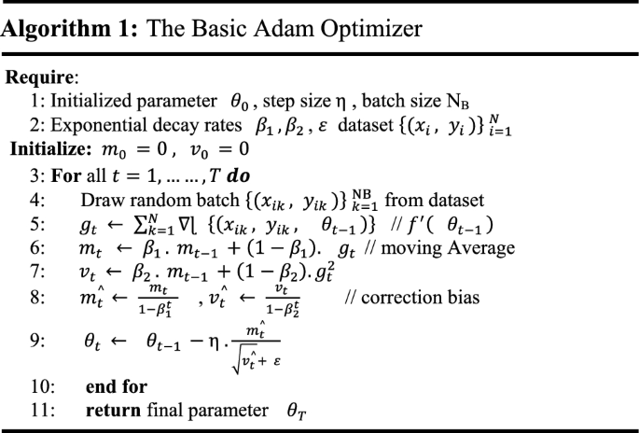
Core Components of an LLM training Checkpoint
1. Model weights
Core parameters: The weight matrices in each Transformer layer ( Attention Q/K/V/O, FFN, LayerNorm, Embedding, etc.)
Distributed storage: In data parallel (DP) each rank stores the same full replica; In tensor parallel (TP)/ pipeline parallel (PP) only the corresponding shard is stored
2. Optimizer state
Checkpoint The largest component, typically 2-4 × the model size:
Adam/AdamW: first momentum + second variance
Learning rate scheduler state: current step, warmup progress, decay state
3. Training state
Global step: the number of training iterations completed
Data loader state: current epoch, data sampler random seed, current read position
Random number generator state: Python/NumPy/PyTorch/CUDA RNG states (to ensure reproducibility)
4. Distributed Training-specific information and other metadata
Parallel group configuration (TP/PP/DP rank mapping and process group information), ZeRO optimizer state (DeepSpeed), FSDP state
Model architecture configuration and training hyperparameters

Slide 11
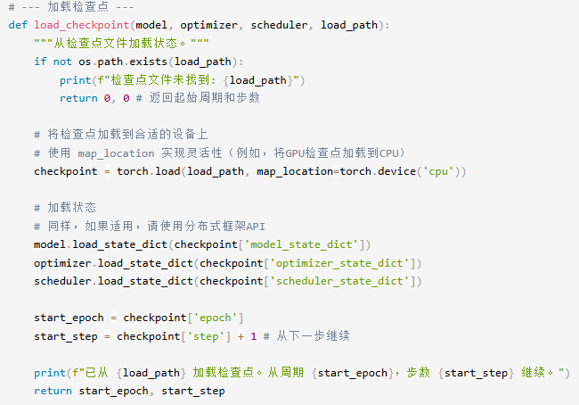
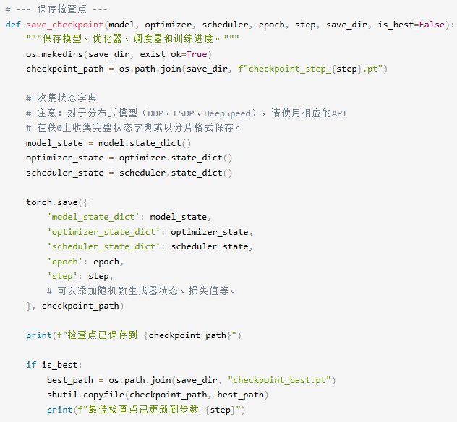
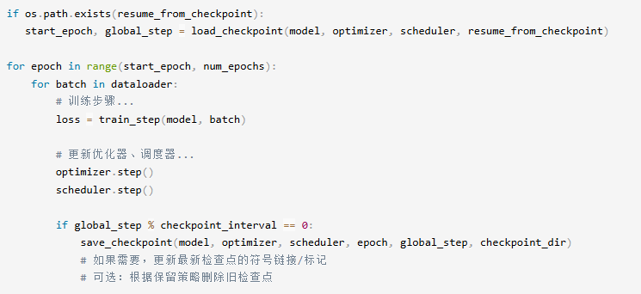
Checkpoint Code Example
PyTorch Checkpoint Example
Load Checkpoint
Save Checkpoint
Examples in the Training Loop
Notes:
https://apxml.com/zh/courses/mlops-for-large-models-llmops/chapter-3-llm-training-finetuning-ops/checkpointing-fault-tolerance

Slide 12
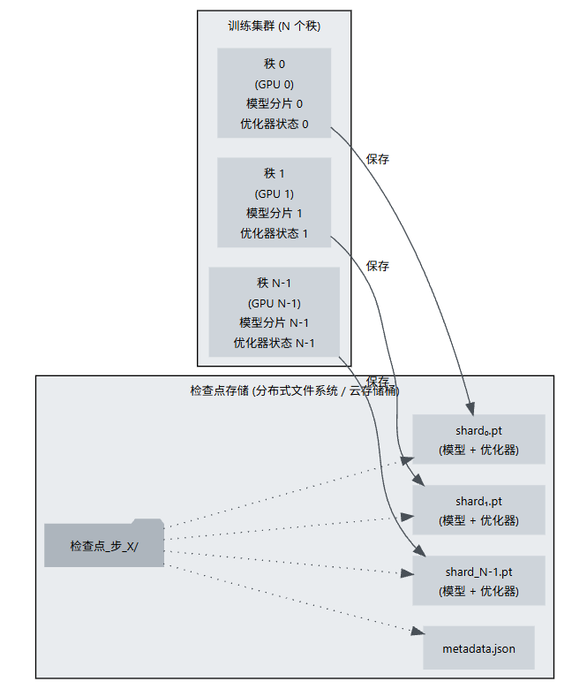
Checkpoint Management in LLM Distributed Training
Parallel Saving
Save checkpoints in sharded format, enabling parallel saving and loading.
Tensor parallelism (TP): In TP, model layers are split across different devices. Each rank retains only a shard of the weights for certain layers. Saving a checkpoint requires each rank to save its specific weight shard.
Pipeline parallelism (PP): In PP, different model layers reside on different rank. Each rank stores the state for the layers it manages.
Metadata Mapping
The system generates an index file.
Records “which portion of the parameters is stored in the snapshot on which GPU”.
Flexibility during loading
Even if the GPU number changes when resuming training (e.g., from 64 to 128), the framework recomputes offsets based on the index file, enabling non-uniform loading.
Diagram of sharded Checkpoint saving. Each Rank saves its portion of the model and optimizer state to a dedicated file in the Checkpoint directory on shared storage. Metadata coordinates these shards.

Slide 13
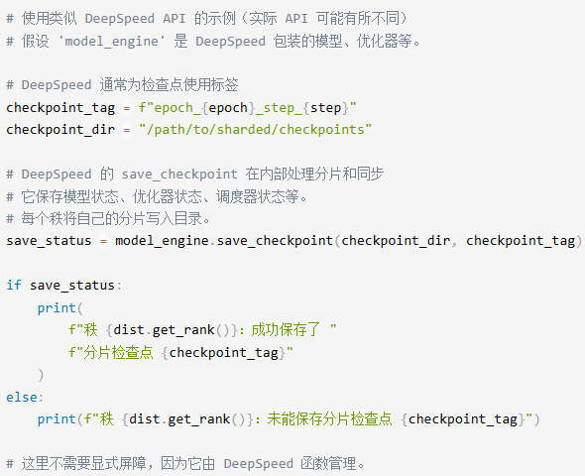
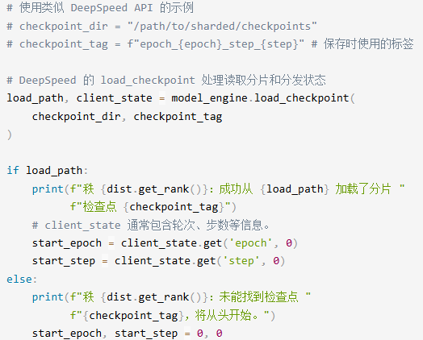
Checkpoint Code Example
DeepSpeed Checkpoint Example
Sharded checkpoint saving: DeepSpeed and Megatron-LM and other libraries provide high-level API that simplify the complexity of managing sharded checkpoints and handling synchronization.
Sharded checkpoint loading: In DeepSpeed and similar libraries, the loading functions read the appropriate shard for each Rank and reconstruct the distributed state.

Slide 14
LLM Training Checkpoint Storage Example
Checkpoint requires enormous storage capacity
GPT-3: 175B => 2.4 TB Checkpoint
LLaMA: 544B => 6~7 TB Checkpoint
GPT-4: > 1 Trillion => 13.8 TB
Checkpoint requires enormous storage bandwidth
Write bandwidth
Checkpoint save time should be kept within 5% of the total time.
Requirement: If a 2.4 TB Checkpoint must be written within 60 seconds, at least 40 GB/s of sustained write bandwidth is required.
Large-scale cluster challenges: As the number of GPUs increases, having each GPU write independently in parallel creates massive I/O concurrency pressure on parallel file systems (such as Lustre, GPFS, JuiceFS).
Read bandwidth
Although reads are infrequent (only during training recovery or task startup), high read bandwidth can significantly reduce fault recovery time, preventing thousands of GPU from sitting idle while waiting for data to load.
Using the GPT-3 175B model as an example
Optimizer: AdamW;
Training precision: BF16;
Distributed: ZeRO-3 (8 GPUs)
Components | Compute | Size
Model parameters (BF16) | 175 B × 2B | 350 GB
Optimizer master parameters (FP32) | 175 B × 4B | 700 GB
First moment m_t (FP32) | 175 B × 4B | 700 GB
Second moment v_t (FP32) | 175 B × 4B | 700 GB
Other states (steps, RNG, etc.) | ~ | ~
Total |  | ~ 2.4TB
Per-rank total after sharding | 2.4 TB / 8 | ~300GB
Notes:
https://www.vastdata.com/blog/a-checkpoint-on-checkpoints-in-llms

Slide 15
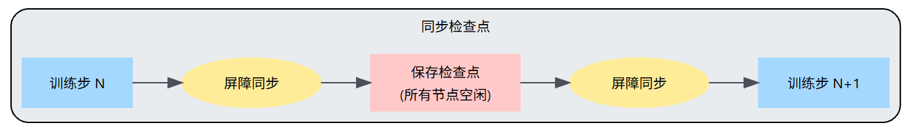
Synchronized checkpoint
Principle
When a Checkpoint is triggered, the training process explicitly pauses all computation and gathers the required state components.
In a distributed training environment, a synchronized checkpoint requires coordination across all participating worker nodes; a barrier synchronization is used before saving.
Advantages
Simplicity: Easy to implement and understand. Save a clear point in time during training to ensure consistency across all worker nodes.
Consistency guarantee: The checkpoint reflects the exact state of the training job at the moment it is triggered. If restored, training resumes exactly from that point.
Disadvantages
Performance overhead: Training stops during saving. Writing large Checkpoints to storage can take a long time, leaving substantial compute resources idle.
Blocking: the entire training process is blocked, reducing overall training throughput.

Slide 16
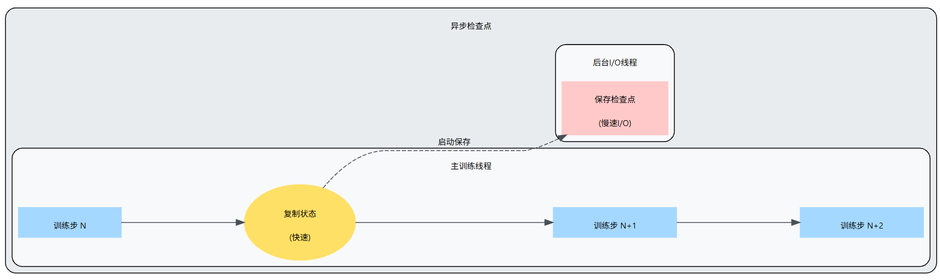
Asynchronous Checkpoint
To reduce the performance overhead of synchronous saving, separate the compute-intensive I/O work of writing checkpoints from the main training loop.
When a checkpoint is triggered, the main process initiates the save operation but does not wait for it to finish.
1> Copy state: quickly copy the required state in memory. This copy should be faster than disk I/O.
2> Offload I/O: hand the copied state off to an independent thread/ process/ dedicated IO node, which performs the actual serialization and writes to persistent storage in the background.
3> Continue training: The main training loop resumes computation almost immediately after replication or handoff begins, overlapping Checkpoint I/O with computation.

Slide 17
Synchronized Checkpoint vs Asynchronous Checkpoint
The best approach depends on the specific training setup and priorities.
Simplicity vs. performance: The synchronized approach is simpler but incurs higher overhead. The asynchronous approach is more complex but significantly reduces idle time.
Storage speed: If Checkpoint storage is extremely fast (e.g., a high-performance parallel file system), the overhead of synchronized saving may be acceptable. If storage I/O is the bottleneck, asynchronous saving is more appealing.
Failure sensitivity: If it is critical to recover to the absolute latest state when a failure occurs, the consistency guaranteed by a Synchronized checkpoint may be preferable. If it’s acceptable to lose a small amount of iteration progress in exchange for higher throughput, the asynchronous approach is a solid choice.
Framework support: Modern Distributed Training frameworks (such as DeepSpeed or PyTorch FSDP) typically provide built-in, optimized Checkpoint support—sometimes including asynchronous options or highly optimized synchronized methods—to minimize blocking time.
Practical implementation
For ultra-large models where Checkpointing takes a long time (several minutes or more), asynchronous Checkpoint is often preferred to maximize utilization of expensive GPU resources; careful implementation and testing are essential to ensure the reliability of the asynchronous saving process.

Slide 18
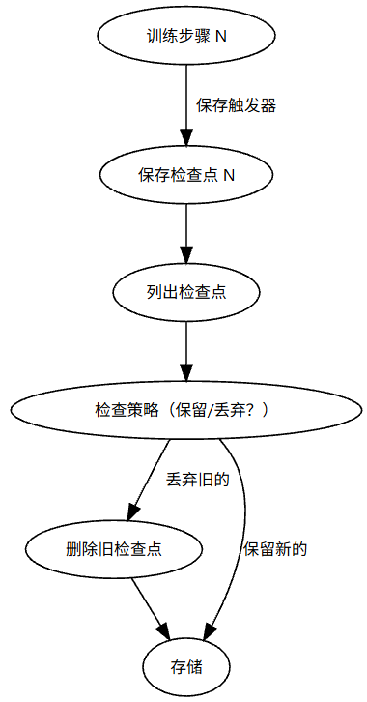
Checkpoint Strategy
Trade-off: minimize work lost during failures vs minimize the overhead of saving checkpoints
High frequency (e.g., every few hundred steps):
Pros: Reduces the loss of training progress when interruptions occur. You can resume from a point closer to the failure.
Drawback: The cumulative overhead of frequent saves increases total training time. It can quickly generate a large number of Checkpoint files.
Low frequency (e.g., every few thousand steps or every few hours):
Pros: Minimizes the impact of Checkpoint overhead on overall training throughput. Slows the rate of storage usage.
Drawback: If a failure occurs between checkpoints, a large amount of progress will be lost. Restarting may require recomputing hours of work.
Checkpoint Trigger strategy
Iteration-based: Save once every N training steps;
Time-based: Save once every H hours.
Checkpoint retention strategy
Keep only the latest: The simplest strategy. After saving a new checkpoint, delete the previous one.
Keep the last K: Keep the most recent K checkpoints. When saving checkpoint N, delete checkpoint N-K.
Keep the best M based on validation: Regularly monitor validation metrics (e.g., perplexity) and keep the best M.

Slide 19
Checkpoint Storage Optimization Techniques: Checkpoint Compression
Numeric quantization and bit-plane compression
Low-bit quantization: Compress the training state from BF16/FP32 to INT8, FP8 or even NF4 (NormalFloat).
Exponent sharing: Share an exponent across tensor blocks and store only mantissas, reducing memory usage.
Mixed-precision snapshots: Keep model weights at high precision, applying lossy compression to optimizer states.
Differential and delta encoding
Residual storage: Record only the delta between the current step and the previous step.
Low-rank decomposition (LoRA-style): Model weight changes as a product of low-rank matrices, and save only these small matrices.
Sparsity and masking techniques
Top-K filtering: Identify the parameters with the smallest updates and set them to zero, storing only gradient updates above the threshold.
Structured pruning: When saving, remove entire rows or columns of neurons that contribute little to the output.

Slide 20
Checkpoint Storage Optimization Techniques: Tiered Storage
Logical architecture of tiered storage
Different storage media differ by orders of magnitude in bandwidth and latency, evolving Checkpoint from “writing to disk in a single step” to “multi-level buffering”
DeepSpeed
Focuses on leveraging the multi-tier storage media within a single node to overcome memory capacity bottlenecks.
ZeRO-Infinity + NVMe Offload: GPU memory → host memory (CPU DRAM) → local high-speed SSD (NVMe) → remote PFS
Megatron-LM
Focuses on mitigating the network and disk strain caused by concurrent writes from thousands of nodes in large-scale clusters.
Distributed Checkpoint: node-local Buffer → parallel file system (Lustre/GPFS) → remote cold backup
Storage hierarchy | Storage medium | Speed (Bandwidth) | Capacity | Role
L1: Memory tier | GPU HBM / Host RAM | Blazing fast | Constrained | Fault recovery: For rapid, seconds-level hot reboot
L2: Local tier | Node-local NVMe SSD | Fast | Moderate | Staging buffer: A buffer layer for asynchronously writing to remote storage
L3: Persistent tier | PFS (Lustre/HDFS) / Object storage | Slow | Unlimited | Final archiving: For long-term backups and model publishing

Slide 21
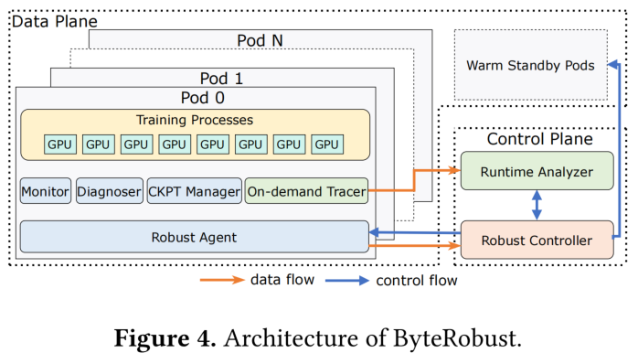
Industry case: Robust LLM Training Infrastructure at ByteDance
Control Plane
Robust Controller: The core scheduler for fault mitigation. Runs automated mitigation algorithms based on multidimensional telemetry data, such as node eviction, warm-backup scheduling, and hot-update restarts.
Runtime Analyzer: A deep analysis engine for non-deterministic exceptions (e.g., Job Hang). By aggregating global stack information, it enables “precise isolation” and “aggressive removal” of faulty nodes.
Data Plane
Robust Agent: Runs as a daemon in each compute container.
Monitor: Fine-grained, real-time self-checks with sub-second fault alerting.
Diagnoser: An in-situ diagnostic toolchain integrating multi-level Benchmark .
CKPT Manager: A high-performance, asynchronous Checkpoint manager for cross-parallel-group backups.
Warm Standby Pods: A pool of standby nodes pre-launched and health-checked in the cluster. By eliminating the “cold start” time spent on resource scheduling and environment initialization, and working with a hot-update mechanism, it enables seamless, minute-level replacement of faulty nodes.
Wan B, Liu G, Song Z, et al. Robust llm training infrastructure at bytedance[C]//Proceedings of the ACM SIGOPS 31st Symposium on Operating Systems Principles. 2025: 186-203.
Notes:
Phase 1: real-time self-checks and rapid response (Proactive Real-time Checks)
Step ① : Detection & Eviction (Detection & Eviction)
The monitor performs real-time checks on hardware ( GPU, network cards, kernel events). Once a confirmed hardware failure is detected (e.g., GPU damage), the system immediately shuts down and evicts the faulty machine.
Step ② : Code rollback (Code Rollback)
If a clear user-space error is detected during runtime (e.g., Python TypeError or IndexError ), the system automatically triggers Code rollback and undoes the most recent updates.
Step ③ : Suspend for diagnostics (Suspend for Diagnostics)
If abnormal metrics occur (e.g., Loss becomes NaN ) or training crashes for unknown reasons, the system suspends training and enters in-depth “ Downtime diagnostics ”.
Phase 2: Tiered downtime diagnostics (Hierarchical Downtime Diagnostics)
Step ④ : Locate and evict (Locate & Evict)
The Diagnostic tool pinpoints the root cause by running targeted tests such as NCCL. After confirming the Faulty point, remove it and lock the IP, then bring the Warm standby machine online to take over.
Step ⑤ : Reattempt (Reattempt)
If all tests pass and the system determines the fault is transient jitter (e.g., a temporary network fluctuation), training is restarted in place.
Step ⑥ : Restart failure reporting (Retry Failure)
If the issue persists after the in-place restart, the system will suspect the most recent Code changes.
Step ⑦ : Still fails after eviction (Eviction Failure)
Even after the machine is evicted, if errors still occur after the restart, this further confirms the issue is with the user code logic or environment configuration, rather than a purely hardware fault.
Phase 3: Complex fault isolation (Advanced Localization)
Step ⑧ : Two-phase replay (Dual-Phase Replay)
To address the most hard-to-detect faults (such as Silent data corruption SDC ), the system performs replay tests by splitting machines into horizontal and vertical groups while keeping variables controlled.
Step ⑨ : Precise exclusion (Intersection Eviction)
By comparing the overlap in error reports between the horizontal and vertical tests, it precisely identifies a single SDC faulty machine and excludes it, ensuring the training environment is fully restored to a healthy state.

Slide 22
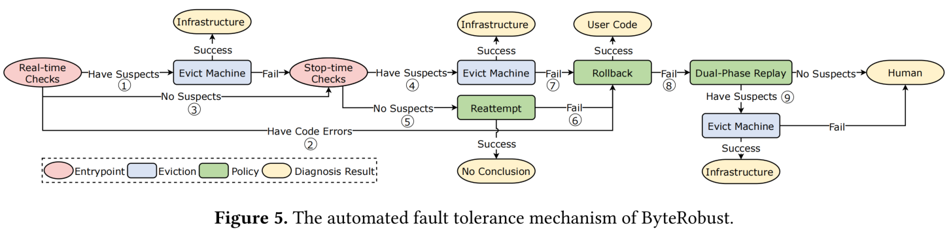
Industry case: Robust LLM Training Infrastructure at ByteDance
Multilevel Checkpoint (Tiered Storage)
In-memory/ local-disk backup: Store Checkpoint first in the memory or local SSD of a nearby machine to enable writes in seconds.
Remote backup: Asynchronously transfer data to persistent storage.
Warm backup and hot-update (Warm Standby & Hot-update)
If only one machine fails, don’t restart the entire 10,000-GPU job. The ByteRobust system reserves a small number of “standby machines” and replaces only the failed one, enabling “hot-pluggable” style rapid recovery.
Results: Fault recovery speed improved by more than 10 times, and the effective training time ratio (ETTR) reached 97%.
Wan B, Liu G, Song Z, et al. Robust llm training infrastructure at bytedance[C]//Proceedings of the ACM SIGOPS 31st Symposium on Operating Systems Principles. 2025: 186-203.
Notes:
Phase 1: real-time self-checks and rapid response (Proactive Real-time Checks)
Step ① : Detection & Eviction (Detection & Eviction)
The monitor performs real-time checks on hardware ( GPU, network cards, kernel events). Once a confirmed hardware failure is detected (e.g., GPU damage), the system immediately shuts down and evicts the faulty machine.
Step ② : Code rollback (Code Rollback)
If a clear user-space error is detected during runtime (e.g., Python TypeError or IndexError ), the system automatically triggers Code rollback and undoes the most recent updates.
Step ③ : Suspend for diagnostics (Suspend for Diagnostics)
If abnormal metrics occur (e.g., Loss becomes NaN ) or training crashes for unknown reasons, the system suspends training and enters in-depth “ Downtime diagnostics ”.
Phase 2: Tiered downtime diagnostics (Hierarchical Downtime Diagnostics)
Step ④ : Locate and evict (Locate & Evict)
The Diagnostic tool pinpoints the root cause by running targeted tests such as NCCL. After confirming the Faulty point, remove it and lock the IP, then bring the Warm standby machine online to take over.
Step ⑤ : Reattempt (Reattempt)
If all tests pass and the system determines the fault is transient jitter (e.g., a temporary network fluctuation), training is restarted in place.
Step ⑥ : Restart failure reporting (Retry Failure)
If the issue persists after the in-place restart, the system will suspect the most recent Code changes.
Step ⑦ : Still fails after eviction (Eviction Failure)
Even after the machine is evicted, if errors still occur after the restart, this further confirms the issue is with the user code logic or environment configuration, rather than a purely hardware fault.
Phase 3: Complex fault isolation (Advanced Localization)
Step ⑧ : Two-phase replay (Dual-Phase Replay)
To address the most hard-to-detect faults (such as Silent data corruption SDC ), the system performs replay tests by splitting machines into horizontal and vertical groups while keeping variables controlled.
Step ⑨ : Precise exclusion (Intersection Eviction)
By comparing the overlap in error reports between the horizontal and vertical tests, it precisely identifies a single SDC faulty machine and excludes it, ensuring the training environment is fully restored to a healthy state.

Slide 23

The Solution: FlagOS, a Unified AI Software Stack

Slide 24








https://space.bilibili.com/3546791834290849
https://github.com/flagos-ai
https://www.zhihu.com/people/95-22-20-18/posts
https://flagos.io/Home

Slide 25

Thanks for your time！

